Slide 1
Microsoft Azure Immersion Workshop: Data Modernization
Session 1: Why Migrate your databases to Azure?

Slide 2

Who am I?
Yannick Liekens
Games
Hiking
Dog person
Work
Orginally planned to be .Net guy
Accidental DBA
Actual DBA

Slide 3
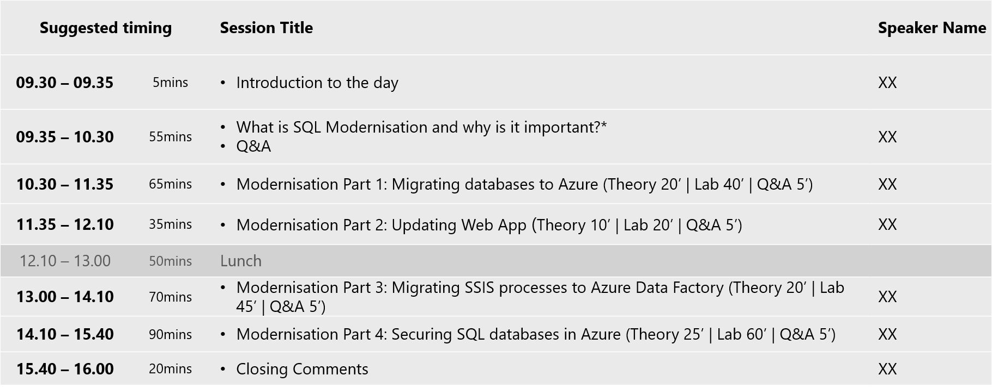

Slide 4
SQL Modernization and why is it important?

Slide 5

Two Years of Unprecedented Change
2020: Responding in real time
2021 and beyond: Recovering and reimagining the future
Remote work and learning
Solutions to maintain business continuity
Employee and customer well-being and safety
Enabling effective hybrid work
Revitalizing stalled business strategies
Resilient infrastructure and fortified disaster recovery strategies
Sustained innovation to meet changing customer behavior
Adoption of emerging technologies to stay competitive
Ensuring employees have the needed skills to be successful
Notes:
Technology changes at very rapid pace -> Keeps speeding up
Had a small issue recently, COVID -> Verkeerscentrum anecdote VPN
Companies looking to progress and further innovate their landscape

Slide 6



Digital transformation is affecting everything
26°
WATER LEVEL
INDOOR TEMPERATURE
LOWER BRIGHTNESS
From 12-3pm
FULL
1,500 STEPS
Fitness tracker
10:30AM MEETING
15-minute reminder
“
Every company is a software company. You have to start thinking and operating like a digital company. It’s no longer just about procuring one solution and deploying one. It’s really you, yourself, thinking of your own future as a digital company.
– Satya Nadella, Microsoft CEO
“
Notes:
More and more data is being captured
A lot of houses for example are becoming more “smart” and more and more data is needed to support that
AI/ChatGPT all of these techonogies needed data storage

Slide 7

Today’s data realities
02-01.01
3
What data do I have?
Data governance
Is it trustworthy?
2
Can people access the data needed to make the right decisions?
Analytics
1
How can I enable faster business insights?
Operational databases
What’s my compliance exposure?
Notes:
The volume, variety and velocity of data are all accelerating dramatically, and the complexity of creating of an enterprise ‘knowledge graph’ can seem insurmountable. Today we generate data far faster than we are able to understand it
In fact, IDC predicts that by 2025, just 5 years from now, the world’s data will climb to 175 zettabytes. To put that in perspective, if you were to store that data in a stack of BluRay discs you’d be able to go to the moon and back 23 times!
Without the right people, processes and capabilities in place, it can be difficult to answer fundamental questions like:
What data do I have?
Is it trustworthy?
Are people getting the data they need to make the right decisions?
Are they getting it fast enough?
And are we managing data in a compliant way?...

Slide 8
IT OPTIMISATION is key to digital transformation
Priorities
Eliminate time spent managing “long tail” of applications—lift and shift to managed cloud
Free-up limited IT resources to drive transformation
Migrate business critical apps to cloud—extend and innovate
SQL Server
37% of all databases run Microsoft, >50% of those run 2008/R2 or older²
END OF EXTENDED SUPPORT SQL 2008 JULY 2019 AND WINDOWS 2008 JANUARY 2020
¹ Pie Chart *IDC Worldwide DB Forecast Dec 2016
² Microsoft Internal Sources
Notes:
I talked a little there about drivers for modernisation Relevant to all IT
In the last 12 months there has been A major DRIVER within the Data Platform landscape;
With the end of support for Windows and SQL 2008 there is a tangible NEED to drive the modernize those platforms
With optimization introducing some new priorities to consider:
Eliminating time spent managing “long tail” of applications
Freeing up limited IT resources
Migrating business critical apps to the cloud
By just migrating at as a minimum you are saving money, saving effort for support and backups with Azure and actually making things compliant just by moving them.
​

Slide 9

Why customers choose to migrate
Urgent Capacity needs
Software & Hardware refresh
Infrastructure
oriented drivers
App oriented modernization drivers
Quickly integrate acquisitions
Security threats
Software end of support
Compliance
Datacenter contract expiry
Application innovation
Migration and innovation triggers
Notes:
Urgent capacity needs + Software and hardware refresh: Client with server, running on max resources -> New vendor application -> order new server takes weeks
Security threats -> Bunch of hacks recently eg last pass

Slide 10
Why customers choose to migrate
Optimize cost
Mitigate risk
Enable innovation
Lowest TCO
Driven by pay-for-what-you-use, automated admin, and HA/DR built-in
Machine Learning-based, continuous performance optimization lowers costs significantly
Automated and modern security capabilities
Powerful security like Advanced Threat Protection built-in
Versionless, managed platform freeing yourself from patching, upgrades, and end of support cycles
Dynamic scale, Global scale by default
Accelerate speed to market and create new business models
Leverage Cloud+Data+AI to unlock your digital transformation scenarios
Notes:
Azure offers a comprehensive mix of technology, best practice guidance, programs, offers, and tools to migrate your entire datacenter to the cloud. Migrate with confidence and optimize your costs with our on-demand global infrastructure with the most regions of any cloud vendor.
Azure is the best cloud destination for your servers, applications, and databases. Our cost saving offers and capabilities are hybrid by design, knowing that you will likely operate that way for the foreseeable future. With Azure, you can be confident that you are running your Windows and SQL workloads at the lowest total cost of ownership versus competitors. Migrate your proprietary or open source databases, modernize your applications, and optimize your costs in the process. In addition to delivering a competitive total cost of ownership (TCO), customers can secure their workloads with industry leading intelligence and built-in security controls. Your business is no longer hostage to the capacity of your data center, and customers can scale their applications on demand to meet the business demands of tomorrow, without having to worry about infrastructure management.
Microsoft Azure is investing in areas to help you weather the crisis and set you up for resilience in the long term.

Slide 11





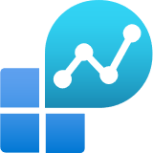
Count on a proven methodology Microsoft Cloud Adoption Framework for Azure
Define strategy
Executive sponsorship
Stakeholder alignment
Partner engaged
Plan
Discovery and assessment
TCO/ Business case
Migration plan
Ready
Technical skilling
Landing zone
Adopt
Migration execution
MIGRATION WAVES
Govern
Manage
Notes:
Based upon the Cloud Adoption Framework, there are critical dimensions every organization should address to prepare for migrations at scale. It is important to understand your current level of readiness for a migration project to be a success. These dimensions span various planning, technical and support aspects of the migration project.
Above view shows how CAF and Migration come together.
Strategy – This is about working with the customer to a) define their cloud strategy/vision/roadmap b) get their leadership team aligned.
Plan – This is about getting a realistic sense of their apps/infra/data estate, do workload discovery/assessment, identify migration workloads/scenarios, and build the business case – all of these feed into a migration plan.
Ready – This is about getting the customer ready to make the move by skilling up their staff. It also includes building the Landing Zone (“helipad” on Azure) for their workloads.
Adopt – This is the phase where you start moving batches of workloads (migration waves), including rightsizing/end-to-end testing prior to cut over.
Governance and Management – You need to maintain an ongoing rhythm of governance and management during and after the move. This includes ensuring backup/monitoring/security etc. as well as things like cost management/subscription management.

Slide 12

THE MODERN DATA ESTATE
Microsoft’s cloud solution for building Systems of Intelligence
Operational databases
Data lakes & analytics
Azure SQL
for relational data
Hyperscale auto-scaling up to 100TB per database
Azure Data Lake
for processing and analytics on data of any size, shape, and speed
99.9% SLA
Azure Cosmos DB
for non-relational/NoSQL data
Guarantees high availability and <10ms latency SLAs
Azure Data Services
Azure Databricks
for big data analytics and AI solutions
Apache spark-based analytics
Azure databases for MySQL, PostgreSQL, and MariaDB
for open source
Enterprise-ready, fully managed database as a service
Azure HDInsight
for open source analytics
Enterprise-grade with over 30 compliance certifications
Data warehouses
Azure Synapse
for complex queries across petabytes of data
40 Azure regions, most availability among all cloud-based data warehouse providers
Reason over any data, anywhere
Flexibility of choice
Security and performance

Slide 13
SQL Server Migrations

Slide 14



Cloud migration strategies
Often referred to as “lift and shift” migration, this no-code option lets you migrate your existing applications to Azure quickly. Each application is migrated as-is, which provides the benefits of the cloud without the risks or costs of making code changes, and you can leverage SQL Server on Azure Virtual Machines, Microsoft’s infrastructure as a service (IaaS) product, to achieve that.
Rehost
Often referred to as repackage, this cloud migration strategy involves some change to the application design but no wholesale changes to the application code. Your application can take advantage of infrastructure as a service (IaaS) and platform as a service (PaaS) products, such as Azure App Service, Azure SQL Managed Instance, and containers.
Refactor
Modify or extend your application's code base to scale and optimize it for the cloud. Modernize your app into a resilient, highly scalable, independently deployable architecture and use Azure SQL Database, Microsoft’s platform as a service (PaaS) offering, to accelerate the process, scale applications with confidence, and manage your apps with ease.
Rearchitect
Rebuild an application from scratch using cloud-native technologies. Azure platform as a service (PaaS) provides a complete development and deployment environment in the cloud, without the expense and complexity of software licenses, the need for underlying application infrastructure, or middleware and other resources. With this cloud migration strategy, you manage the applications and services you develop, and Azure manages everything else.
Rebuild
For more information about cloud migration strategies, see Start your cloud migration process.
Notes:
Now that you’ve decided you want to migrate, how exactly do you get there? Azure offers various methods to help you get to the cloud.
You may choose to “rehost” or “lift-and-shift” your database as is to the cloud, and place is on SQL Server on Azure VMs, allowing you to make no changes to your pre-existing application.
However, you may find that you’d like to move to a PaaS offering, such as Azure SQL MI, in which case you’d have to apply some changes to your application design to get it to the cloud. This is what is known as refactoring your application/database.
Or you may want to start fresh and rebuild a cloud-native application on Azure SQL Database, in which case Azure offers the tools to help you get there as well.
Whichever option you choose to take, Azure has the tools and resources available to help you get there.

Slide 15
Migrating your database to Azure
Azure provides wide database options for your workloads
On-premises SQL Server | Hybrid Cloud Azure Arc enabled data services for Azure SQL MI and Azure Database for PostgreSQL | IaaS SQL Server on Azure VMs, MySQL, PostgreSQL and MariaDB | PaaS Azure SQL; Azure Database for MySQL, PostgreSQL and MariaDB; Azure Cosmos DB; Azure MI for Apache Cassandra
Intelligent Features |  |  |  | Intelligent security and performance features
Managed by Microsoft |  | High availability/DR/Backups Database provision/Patch/Scaling | Virtualization Hardware Datacenter management | High availability/DR/Backups Database provision/Patch/Scaling OS provision/patching Virtualization Hardware Datacenter management
Managed by customer | Applications Data High availability /DR/Backups Database provision/ Patch/Scaling OS provision/patching Virtualization Hardware Datacenter management | Applications Data OS provision/patching Virtualization Hardware Datacenter management | Applications Data High availability/DR/Backups Database provision/Patch/Scaling OS provision | Applications Data
Notes:
Azure PaaS databases are fully managed, enterprise-ready community databases-as-a-service to help you focus on your app, not your database
Protect data with greater manageability and security
Speed queries and insights with better performance and intelligence
Deploy apps globally in minutes
Save time with built-in tools and resources
Improve TCO with built-in features for HA, performance and security

Slide 16




Azure SQL
The family of SQL cloud to edge databases
SQL Server on Azure Virtual Machines
Azure SQL Managed Instance
Azure SQL Database
Azure SQL Edge
Best for lift and shift and/or workloads requiring OS-level access
Best for modernizing existing apps
Best for supporting modern cloud apps
Best for extending apps to IoT edge
Infrastructure-as-a-Service
Platform-as-a-Service
Edge Computing
Azure SQL enabled by Azure Arc
Run Azure SQL on premises and in multi-cloud environments
Azure is the cloud that knows SQL Server best
Notes:
Azure SQL is a family of fully-managed, secure and intelligent SQL database services. Azure offers the widest range of deployment options for SQL from edge to cloud. With Azure SQL, you can rehost SQL workloads on SQL Server on Azure Virtual Machines, modernize existing applications with Azure SQL Managed Instance and support modern cloud applications with Azure SQL Database and Azure SQL Edge.
Azure SQL is built upon the same SQL Server engine, so you can migrate applications with ease and continue to use the tools, languages and resources you’re familiar with. Your skills and experience transfer to the cloud and edge, so you can do even more with what you already have.
The services within Azure SQL support a variety of scenarios:
SQL Server on Azure Virtual Machines
Lift-and-shift your SQL workloads with ease and maintain with 100% SQL Server compatibility and operating system-level access
Azure SQL Managed Instance
Modernize your existing SQL Server applications at scale with an intelligent fully managed service
Azure SQL Database
Support modern cloud applications on an intelligent, managed service that includes serverless compute
Azure SQL Edge
Run IoT edge compute with a SQL database optimized with data streaming, time series, and AI capabilities built-in
SQL Server on Azure VMs and SQL Managed Instance are also now Azure Arc enabled, allowing you to run these services on the infrastructure of your choice, when a hybrid approach is required.

Slide 17
Azure SQL is the best choice for SQL Server workloads
Run any workload anywhere on the industry-leading SQL Server engine
Fully-managed and always up to date
Use your existing SQL experience in the cloud
Save with the lowest total cost of ownership
Protect your data with built-in, real-time intelligent security
Be more productive with AI-powered features that automate tasks and optimize performance for you
Build on what you know with a consistent code base and deploy it anywhere from edge to cloud
Get more cloud for less with leading price-performance and savings up to 85% off pay-as-you-go rates with Azure Hybrid Benefit.
Secure your data with layers of protection, built-in controls, intelligent threat detection, and the broadest set of compliance offerings
The only cloud with evergreen SQL
Software is continually updated and never requires patches
Notes:
And why run SQL on Azure? Well, Azure SQL is the best choice for SQL Server workloads, with each of the services within the family built upon the same SQL Server engine you’re already familiar with.
Azure SQL:
Is Fully-managed and always up to date, allowing you to spend more time innovating and less time patching, updating, and backing up your databases. Azure is the only cloud with evergreen SQL that automatically applies the latest updates and patches so that your databases are always up to date—eliminating end-of-support hassles.
Let’s you use your existing SQL experience in the cloud. Built on the same SQL Server technology that you’re already familiar with, so you don’t need to relearn your SQL skills when you make the move. Develop your application once using your existing SQL skills and deploy it on any Azure SQL cloud database on Azure.
Helps you save with the lowest total cost of ownership. Get industry-leading pricing and maximize your existing on-premises investments when you migrate your SQL Server databases to Azure:
Save up to 85 percent¹ off pay-as-you-go pricing when you bring your existing SQL Server licenses to Azure with Azure Hybrid Benefit.
Get more cloud for less when you combine Azure Hybrid Benefit with reservation pricing.
Qualify for discounted rates to support your ongoing development and testing on Azure.
Spend less time monitoring your workloads with a single portal that lets you view all of your Azure SQL databases, virtual machines, pools, and instances in one place.
Protects your investment with built-in, intelligent security. Remediate potential threats in real-time with intelligent threat detection and proactive vulnerability assessment alerts. Get industry-leading, multi-layered protection with built-in security controls including T-SQL, authentication, networking, and key management. Take advantage of the most comprehensive compliance coverage of any cloud database service.

Slide 18
Which Azure SQL offering is right for you?
App Innovation
Benefits of PaaS
Lower administrative burden
No End of Support hassles
Fully managed and always up to date
Dynamic resource scaling
Built-in high availability and automatic backups
Multimodel capabilities
Do you need
A database model?
Resource pooling for multi-tenant SaaS?
Up to 100TB of database storage?
To automatically pause/restart a workload?
Yes
Azure SQL Database
No
App Modernization
No
Do you need
*
An instance model?
On-premises SQL Server compatibility?
Native vNet support?
Near real-time data replication from on-premises to the cloud?
Yes
Azure SQL Managed Instance
Migration
No
Benefits of IaaS
Maintain OS-level control
Easy lift-and-shift eliminates app refactoring
Faster path to the cloud
Do you need
*
OS level access?
Capabilities at the VM level?
SQL Server versions 2008 - 2019?
SSRS/SSAS?
Yes
SQL Server on Azure VMs
* Use Azure Arc to enable the same services in your datacenter or on the cloud of your choice, when a hybrid or multi-cloud approach is required
Notes:
We understand that it’s not always easy to know where to start, so we’ve created this simplified flow chart with some key features of each database offering to help you choose the best destination for your needs.
If you know you’ll need OS level access and don’t want to make changes to your existing codebase, then SQL Server on Azure VM is the right option for you.
If your goal is to modernize an existing application, and want to take advantage of all the features of Azure PaaS, then Azure SQL MI may be the right fit. With a few tweaks to your existing application, you should be able to run on MI and take advantage of your instance easily.
And finally, if you’re looking to begin building cloud-native applications on Azure, or are looking for the flexibility to automatically pause and resume intermittent workloads, then Azure SQL Database is the perfect choice.
Once on Azure, take advantage of all Azure SQL has to offer.

Slide 19


Your business intelligence tools in Azure
Move to Azure VMs or choose managed services for data integration and analysis
SSIS
SSIS in Azure Data Factory (ADF)
Your platform for building data integration and transformation solutions
SSRS
Power BI (PBI)
Your platform for creating, deploying, and managing mobile paginated reports
SSAS
Azure Analysis Services (AAS)
Your platform for creating and analyzing tabular data models
SSAS
SQL Server Analysis Services (IaaS)
Your platform for creating and analyzing multidimensional data models
Notes:
A migration to the cloud does not mean leaving behind all your expertise and knowledge. On SQL Server on Azure VMs, you have the freedom to continue using the business intelligence tools you know and love.
However, if you choose to migrate to Azure SQL Database or MI, you may find that some of these tools you’re familiar with aren’t available on Azure PaaS. For the managed services, we offer comparable features to the ones you are used to working with, such as ADF SSIS for SSIS, Power BI for SSRS, and Azure Analysis Services for SSAS and SQL Server Analysis Services for SSAS.

Slide 20
Key offers lower your total cost of ownership
Azure Hybrid Benefit
Maximize existing investments in on-premises licenses with discounted rates on Azure SQL Database. Save up to 59% vs. AWS.
Reserved capacity
Reserve Azure SQL resources in advance and save up to 33%. Combine with Azure Hybrid Benefit for savings up to 80%.
Dev/test pricing
Save up to 55% versus list prices, eligible with active Visual Studio subscriptions .
Extended security updates
Get free extended security updates for SQL Server 2008/R2 and SQL Server 2012 for three years when running on Azure Virtual Machines.
Notes:
We know that optimizing for costs is a crucial piece to any change within a business, that’s why Azure offers key benefits to help you get the most out of your investment.
With AHB, bring your pre-existing SQL Licenses with active Software Assurance to the cloud and save up to 59% vs other cloud providers. Leverage your on-premise time and monetary investments by bringing both skills and licenses to Azure SQL.
With RC, pay for resources up front and save up to 33% on list price by making a one or three year commitment. You can combine this with AHB to save up to 80% in Azure.
If you’re still in the development/testing phase of your product, take advantage of special Dev/Test pricing, available with an active Visual Studio subscription, and save up to 55% vs list price.
And finally, take advantage of the only cloud that offers free extended security updates for your SQL Server 2008/2008R for the next 3 years if you choose to run on Azure VMs.

Slide 21
Azure Hybrid Benefit for SQL Server
Azure only benefit for customers with active SA or subscriptions on SQL cores
Significantly reduce the costs of running SQL IaaS and PaaS in Azure
Azure SQL Database Business Critical
8 vCores, US West 2, 730 hours per month
Pay only the ‘base rate’ in Azure on SQL IaaS, SQL Database, SQL Managed Instance, and ADF v2 SSIS
~55% LESS
Available for SQL Server core licenses only
Azure SQL Database Business Critical
8 vCores, US West 2, 730 hours per month
Customers can use their cores on-premises, OR as vCores in Azure
However, cores can be used on-premises and in Azure simultaneously for up to 180 days, to allow for migration
$3,967.91
$1,777.91
Without Hybrid Benefit
With Hybrid Benefit
*Combining the Azure Hybrid Benefit for Windows and SQL
Notes:
The Azure Hybrid Benefit for SQL is an Azure benefit for customers with active software assurance (including subscription licensing) on their SQL cores.
Customers can use their cores on-premises, or as vCores towards eligible Azure data services, detailed on the following slide. By using this benefit, the customer is charged the ‘base rate’ in Azure, which excludes the charges
Note this benefit is core only. If customers have server/CAL licensing they will not be able to leverage the Azure Hybrid Benefit and should consider moving to the Core model
The ‘base rate’ is the cost of compute, storage, backup, and any I/O charges that may apply. SQL license costs are waived

Slide 22
Why should SQL VM customers continue to modernize on Azure SQL managed databases?
Key report benefits and findings¹
Up to 47%
Cost savings on Azure SQL VMs vs on-premises SQL Server
Innovate faster and accelerate time to market
Always operate on the latest version of SQL
Modernizing on Azure SQL yields even greater benefits…
Increase operational efficiency and savings
53%
Lower cost of application administration
+17%
Additional cost savings on Azure SQL managed databases vs Azure SQL VMs
Eliminate software expenses
+$30M
Additional revenue due to faster time to market
90%
Lower cost of systems administration
Improve business agility
¹ Results are based on interviewed customers. “The Economic Value of Migration On-premises SQL Server Instances to Microsoft Azure SQL Solutions,” a commissioned study conducted by The Enterprise Strategy Group on behalf of Microsoft, October 2020.
Notes:
If you’ve already migrated your existing workloads to SQL VMs, why continue to modernize on Azure SQL’s fully managed database offering?
When you modernize onto intelligent, fully managed Azure SQL solutions, you’ll benefit from a service that does more on your behalf, freeing you to focus on higher priorities than day-to-day database administration.
Innovate faster and accelerate time to market - Innovate faster and accelerate your time to market by shifting from database operations to app management
Always operate on the latest version of SQL - Always up to date with the latest SQL features and functionality. Never worry about updates, upgrades, or end of support again.
Increase operational efficiency and savings - Boost productivity and operate more efficiently by letting the service perform time-consuming and complex tasks, like backups and HA, on your behalf.
Eliminate software expenses - Eliminate licensing and OS costs
Improve business agility - Easily scale up or down to quickly meet changing workload demands.
Enterprise Strategy Group recently published a commissioned study that looked at the potential savings and operational benefits of migrating from on-premises to Azure SQL, first to IaaS and then continuing to PaaS.
ESG saw that modernizing on Azure SQL’s managed databases provided an incremental +17% cost savings vs Azure SQL VMs, but also significant reductions in app and systems administration costs.
The benefits of fully-managed services are compelling, but ultimately you need to decide which Azure SQL options are right for you.

Slide 23




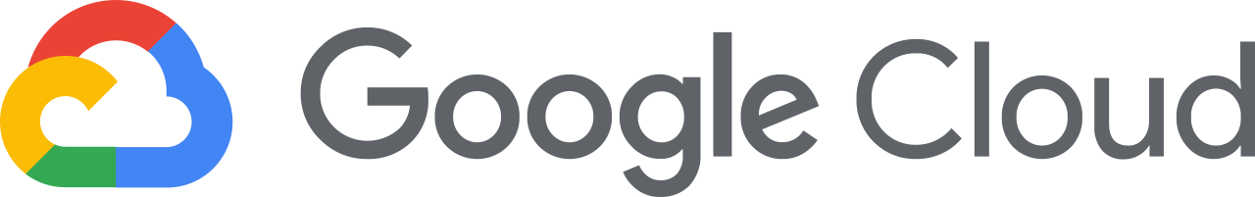

Migrate “in-place” with Azure Arc
Azure
Secure, develop and operate
Security & Governance
Dev tools & practices
App, data & ML services
Azure Arc
Azure Stack HCI
Azure IoT
On-premises, multicloud, and edge
Notes:
In Azure, we’ve put a premium on making it easy to secure and govern servers, applications, and databases with powerful management and security and management services. We have built a flexible and open platform where you can use familiar dev tools, like Visual Studio and GitHub when building the next generation of applications. We also offer a wide range of first-party services from Microsoft - application, data, AI, and ML services, so you can innovate anywhere.
With Azure Arc, we’re creating a bridge between Azure and your other environments - on-premises, multicloud and edge, to bring you all these great innovations.
And we’re doing it in a way where you can confidently invest in a single set of skills and processes that you can transfer wherever they’re needed.
A top of mind concern among our customers has been keeping their Windows Server and SQL workloads running and recoverable in the case of unforeseen events or disasters. Azure provides built-in solutions for customers to implement simple, secure and cost-effective Business Continuity and Disaster Recovery (BCDR) strategies for their applications and data – whether their workloads remain on-premises or have migrated to the cloud.
The reason that we are able to offer hybrid azure solutions that bring the cloud from on-prem to the edge is the level of consistency of our app, data, identity, and security and management offerings across on-prem and cloud. The fact that you are running the same WS and SQL server in the cloud and on-prem makes it easy to migrate and means you can use your existing IT skills.

Slide 24


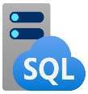

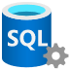


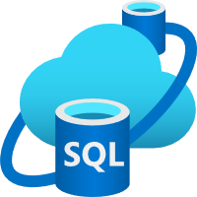


SQL Server 2022 Azure-enabled with continued performance and security innovation
Business continuity through Azure
Seamless analytics over on-prem operational data
Visibility over your entire data estate
Most secure over the last 10 years¹
Industry-leading performance and availability
Microsoft Purview
+
Data Insights
Data Catalog
#1 OLTP performance²
#1 Non-Clustered DW performance on 1TB³, 3TB⁴, 10TB⁵, 30TB⁶, and 100TB⁷
Data Map
Hero capabilities
Bidirectional DR to Azure SQL⁸
Azure Synapse Link
Microsoft Purview integration
SQL Server ledger
Built-in query intelligence
Multi-write replication
Most consistent data platform
Edge to Cloud
Azure SQL Edge
Azure Arc-enabled data services
Azure SQL
All TPC Claims as of 04/06/2022.
¹National Institute of Standards and Technology Comprehensive Vulnerability Database ² http://www.tpc.org/4087; ³ http://www.tpc.org/3374; ⁴ http://www.tpc.org/3380; ⁵ https://tpc.org/3383; ⁶ http://www.tpc.org/3364; ⁷ https://tpc.org/3382;
⁸Bidirectional disaster recovery capability of link feature for Azure SQL Managed Instance public preview will occur at a future date.

Slide 25
Count on a proven methodology Microsoft Cloud Adoption Framework for Azure
Define strategy
Executive sponsorship
Stakeholder alignment
Partner engaged
Plan
Discovery and assessment
TCO/ Business case
Migration plan
Ready
Technical skilling
Landing zone
Adopt
Migration execution
MIGRATION WAVES
Govern
Manage
Notes:
Based upon the Cloud Adoption Framework, there are critical dimensions every organization should address to prepare for migrations at scale. It is important to understand your current level of readiness for a migration project to be a success. These dimensions span various planning, technical and support aspects of the migration project.
Above view shows how CAF and Migration come together.
Strategy – This is about working with the customer to a) define their cloud strategy/vision/roadmap b) get their leadership team aligned.
Plan – This is about getting a realistic sense of their apps/infra/data estate, do workload discovery/assessment, identify migration workloads/scenarios, and build the business case – all of these feed into a migration plan.
Ready – This is about getting the customer ready to make the move by skilling up their staff. It also includes building the Landing Zone (“helipad” on Azure) for their workloads.
Adopt – This is the phase where you start moving batches of workloads (migration waves), including rightsizing/end-to-end testing prior to cut over.
Governance and Management – You need to maintain an ongoing rhythm of governance and management during and after the move. This includes ensuring backup/monitoring/security etc. as well as things like cost management/subscription management.

Slide 26
Start your migration journey today
Secure and manage
Assess
Migrate
Optimize
Discover, assess and estimate cost to run your databases in Azure with Azure Migrate
Use the Azure Database Migration Service to migrate your on-premises database to Azure
Take advantage of offers such as Azure Hybrid Benefit and Azure Reserved Instances
Get industry-leading security with Azure Security Center, and protect your data in the cloud with Azure Backup
Notes:
Start your migration to Azure today!
Begin by assessing your environment and receiving an estimated monthly cost with our Azure TCO calculator
Then begin the migration using DMS and the Data Migration Assistant, found within Azure Migrate
Once on Azure, ensure to optimize your environment to efficiently run your workloads, and take advantage of cost-saving opportunities with AHB and Reserved Capacity
Stay on top of security and any detected threats in the Azure Security Center, and ensure that you won’t lose any data during an unexpected outage by setting up database backups.

Slide 27




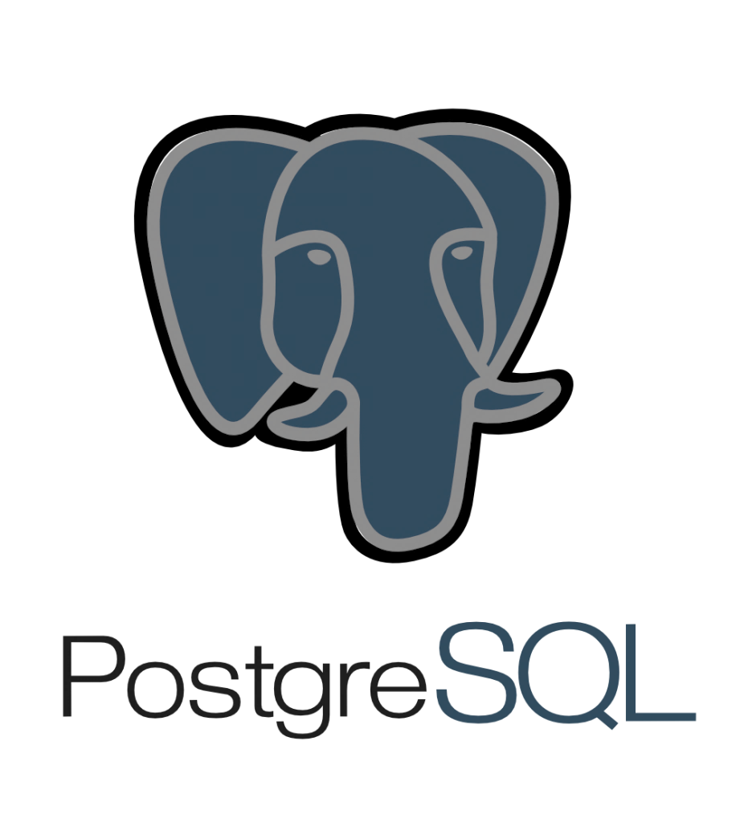






Tools and services for your migration journey
On-premises
Other clouds
Microsoft Azure
Assessment
Migration
Azure Migrate
Azure Database Migration Service, Azure SQL Migration extension in Azure Data Studio
Notes:
We have a portfolio of migrations tools based on your desired migration source and migration targets

Slide 28
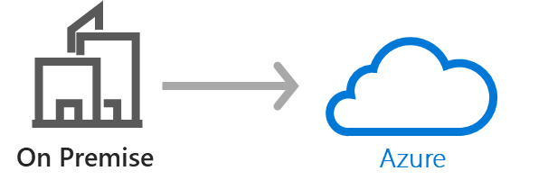

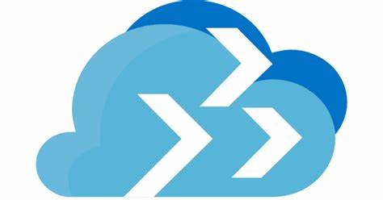



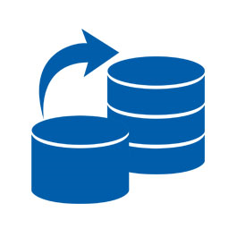


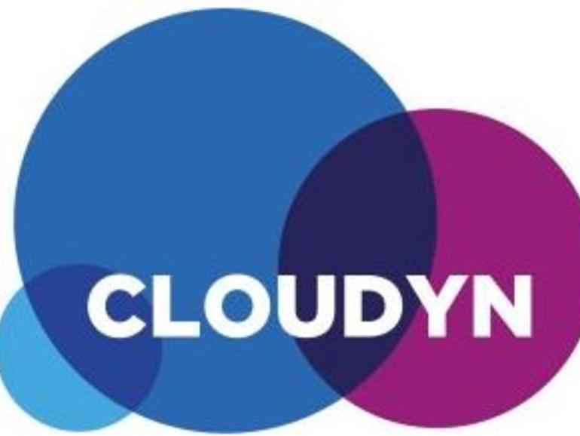





SQL SERVER database migration process
OUTCOMES
TOOLS
Inventory database assets, and application stack discovery
Assess your databases, Apps and components
Choose Deployment Model
Build a migration plan / pilot
Discover & Assess
Microsoft Assessment Planning Toolkit
Azure Migrate
Database Migration Assistant (DMA)
Build identity, network, storage and compute infrastructure
Migrate Security and Logins
Migrate your workloads
Migrate
Azure Migrate
Azure Site Recovery
Database Migration Service (DMS)
Perform Tests
Iteratively make any necessary changes to your Databases & Applications
Update Connection Strings
Optimise
Database Experimentation Assistant (DEA)
Cost Management
Set up data protection, including backup and disaster recovery
Incorporate security management and monitoring
Integrate health and performance monitoring
Secure & Manage
PaaS Backups
& Long term Backup
Azure Monitor SQL Insights & Log Analytics
Azure Security
Centre

Slide 29
Get free Azure migration tools Azure Migrate: A central hub for datacenter migration
Multiple scenarios
Migrate Windows and Linux Servers, Databases, Data, Web Applications and Virtual Desktops
Diverse capabilities
Comprehensive discovery, assessment, and migration capabilities powered by Azure and third-party tools
Azure Migrate
Centralized visibility
Centralized migration repository delivering end-to-end tracking and insights
Notes:
Discover, assess, and migrate on-premises applications, infrastructure, and data. Centrally plan and track the migration across multiple Microsoft and independent software vendor (ISV) tools.
A comprehensive approach to migrating your application and datacenter estate. Supports key migration workloads like Windows Server, Linux, SQL and other Databases, data with Data Box, Web Applications, and Workstations (including Virtual Desktop Infrastructure). Holistic across VMware, Hyper-V, physical server, and cloud-to-cloud migration.

Slide 30
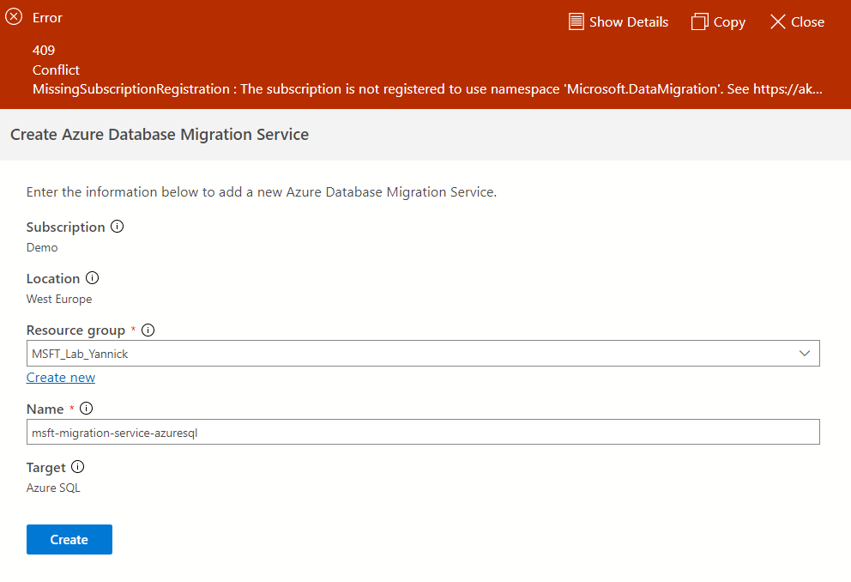
DMA Demo
Demo MAP Tool
Demo DMA

Slide 31
Lab info
Sign-Up Link (For All): https://bit.ly/3XEWDzw

Slide 32
Updating the Web app

Slide 33
SSIS to ADF

Slide 34
What is SQL Server Integration Services
Orchestration tool
ETL
Business processes
Notes:
Atris Witnessing
Emmaus backups

Slide 35
Administering, monitoring and tuning databases in Azure

Slide 36
Core Database Administration Automation
ZERO CONFIGURATION
Backups
DBs use Full Recovery mode by default
7 days PIT backups are held
Can be extended to 35 days
Long Term Retention backups can be configured
Encryption
SQL Transparent Data Encryption on by default
Keys are either:
Managed by us
BYOK & stored in Azure Key Vault
High Availability
DBs/Managed Instances run on a 4-node SQL Server Always-On High Availability cluster
Geo-replication & Auto Failover Groups
Zero admin overhead with 99.99% availability
Patching
Ever-green SQL – always patched, always v-Next
Compatibility Level SQL2008 DBs upwards
HA stand-by nodes are patched then fail-over & patch 4th node
Notes:
Let’s start with the core database administration activities & what they look like in this world of managed services and PaaS platforms.
Well a PaaS platform by design automates some of the business critical but quite frankly more mundane database chores so let's run through some of them:
Backups By default, if you do nothing at all, all Azure SQL DBs (including those hosted on Managed Instance) run in Full Recovery mode providing point-in-time recovery to any moment in the last 7 days. Backups are auto encrypted and tested for integrity & validity and all this is included in the cost you see in the Azure portal. The PIT recovery window can be extended to 35 days and Long-Term Retention backups can be easily automated to create period end snapshots for compliance & auditing reasons and be kept for up to 10 years.
Encryption SQL Server TDE is a mature, robust technology that’s enabled by default meaning all SQL data at rest on disk is encrypted. Encryption is one of the most affective security mechanisms so whether you want a completely transparent, zero configuration service or one where you bring & manage your own keys, Azure SQL DB provides this capability for you.
High Availability Under the hood, all Azure SQL Databases & Managed Instances run on a 4-node SQL-High Availability cluster using the same SQL-HA technology that’s been available with SQL Server for over a decade. So every time you look in the Azure Portal & buy a vCore for one your Azure SQL DBs, behind the scenes you’re actually getting 4 vCores to support the HA cluster. This means the cost & very real complexity of a SQL High-Availability environment is completely taken away & hidden – we do it for you and it’s how we deliver our 4x9s availability SLA for all flavours of Azure SQL Database. And if you need to make your databases geo-resilient Geo-replication and Auto Failover Groups let you set-up an asynchronous copy in another Azure Region in just a few clicks.
Patching The 4-node cluster that underpins all Azure SQL DBs also allows us to automatically patch the SQL environment with minimal impact upon you. We patch the 4 nodes in the cluster on a round-robin basis failing-over the active node onto an already patched stand-by node. The only down-time required is the time it takes the active node to fail-over which in worst case is a few seconds and may even be as low as a few milliseconds depending on the performance tier your using. The result of this is that you never need to patch nor upgrade your SQL environment again as you’ll always be running on SQL V-Next with latest patches applied in this ever-green environment. To make sure engine behaviour changes don’t impact your database code we run all DBs using the relevant SQL Server Compatibility Mode – a robust & mature technology that’s been around in SQL Server since 2008, and it allows us to run different versions of the engine for specific databases.
And everything we’ve just described here is out-of-the-box, default behaviour requiring zero-configuration from you and it’s all included in the cost you see.

Slide 37

SQL tuning
Notes:
Back in the day, bought servers doesn’t matter if app does bad as long as server can pull it
Now scale up down / performance matters

Slide 38
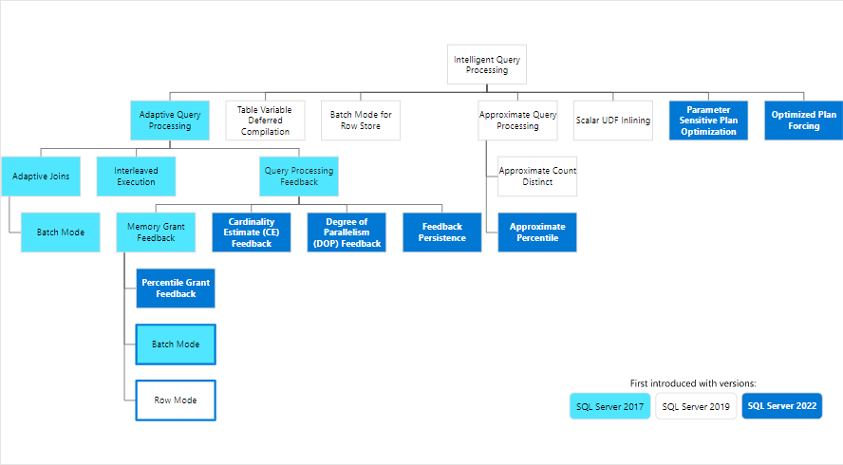
SQL tuning
Notes:
New version -> New performance features
However, new versions can also regress some queries -> Hence monitoring

Slide 39
Database Monitoring Tools (reference slide)
 | What is it? | When to use it
SQL Database Overview blade | Summary/high-level performance dashboard on the database Overview blade At-a-glance monitoring view Drill-into and Alert set-up | Smaller organisations Light data processing requirements Introduction to DB performance management
Intelligent Performance | DB level monitoring Query performance & auto tunning tools Built on SQL Query Store – black box telemetry recorder, caught every 15 secs, stored for 1 hour | Troubleshooting query performance Useful for Devs & DBAs Can auto-apply fixes and revert changes if performance degrades
DMVs | Collection of built in TSQL “management views” Expose huge amounts of state, health & performance telemetry | Very flexible, very powerful manipulation of telemetry data Highly detailed reporting and automation
Azure SQL Analytics (preview) | Separate service outside of Azure SQL – central reporting for all SQL Built on Log Analytics, data stored for extended period, massively scalable | Powerful centralised monitoring and logging for large data estates 3rd-party & custom processing of log & telemetry data

Slide 40
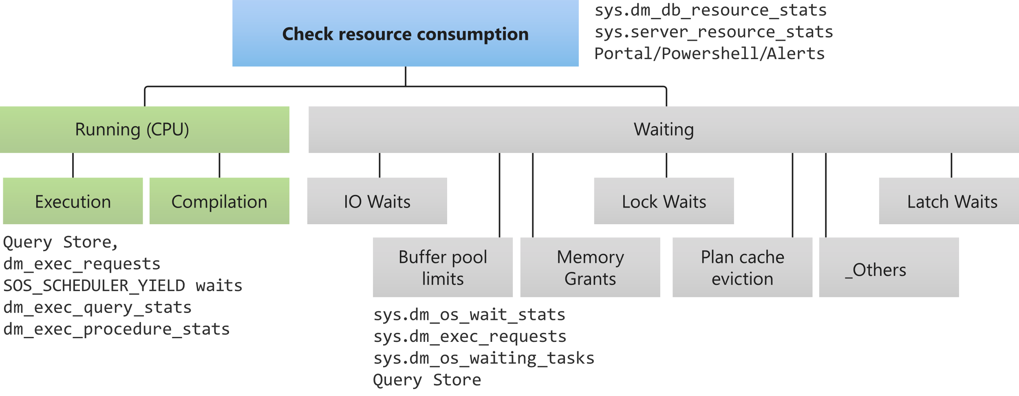
Troubleshooting approach – Running or Waiting?
Notes:
Any performance issue with SQL Server falls into 1 of 2 fundamental categories: Running or Waiting.
Either we’re waiting on the CPU to complete Running the query or the query is blocked from executing because it’s Waiting on some other resource to be come available.
Whilst not exhaustive this diagnostic tree provides good starting point for tools & specific DMVs that can help you identify the root cause of a performance issue whether it be down to Running or Waiting.

Slide 41
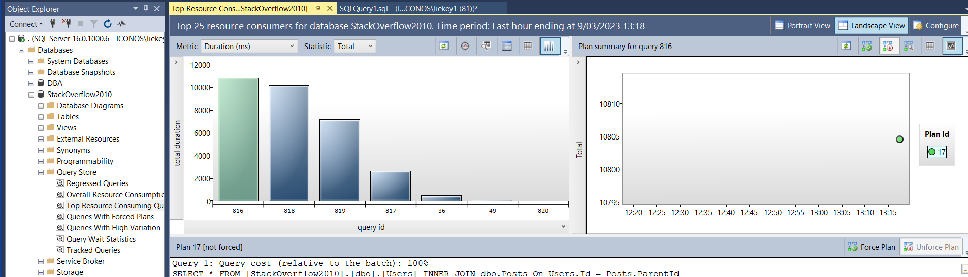
Query store
Free
SQL 2016 +
In dept query analysis
Easy to use
Notes:
Start your migration to Azure today!
Begin by assessing your environment and receiving an estimated monthly cost with our Azure TCO calculator
Then begin the migration using DMS and the Data Migration Assistant, found within Azure Migrate
Once on Azure, ensure to optimize your environment to efficiently run your workloads, and take advantage of cost-saving opportunities with AHB and Reserved Capacity
Stay on top of security and any detected threats in the Azure Security Center, and ensure that you won’t lose any data during an unexpected outage by setting up database backups.

Slide 42
DMVs
https://glennsqlperformance.com/resources/

Slide 43
IAAS/Managed instance
DBA Community open source tools:
Brent Ozar
Sp_WhoIsActive
Notes:
Start your migration to Azure today!
Begin by assessing your environment and receiving an estimated monthly cost with our Azure TCO calculator
Then begin the migration using DMS and the Data Migration Assistant, found within Azure Migrate
Once on Azure, ensure to optimize your environment to efficiently run your workloads, and take advantage of cost-saving opportunities with AHB and Reserved Capacity
Stay on top of security and any detected threats in the Azure Security Center, and ensure that you won’t lose any data during an unexpected outage by setting up database backups.

Slide 44
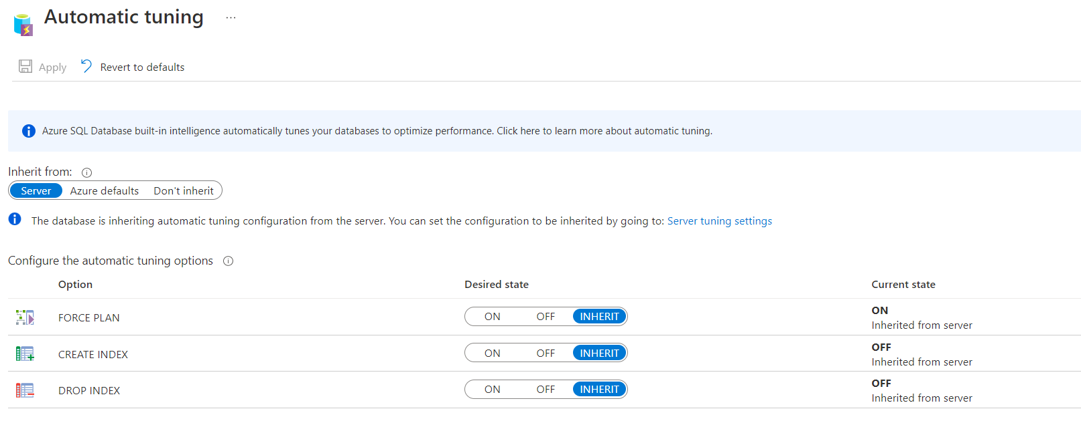
Automatic tuning

Slide 45
Securing your data

Slide 46
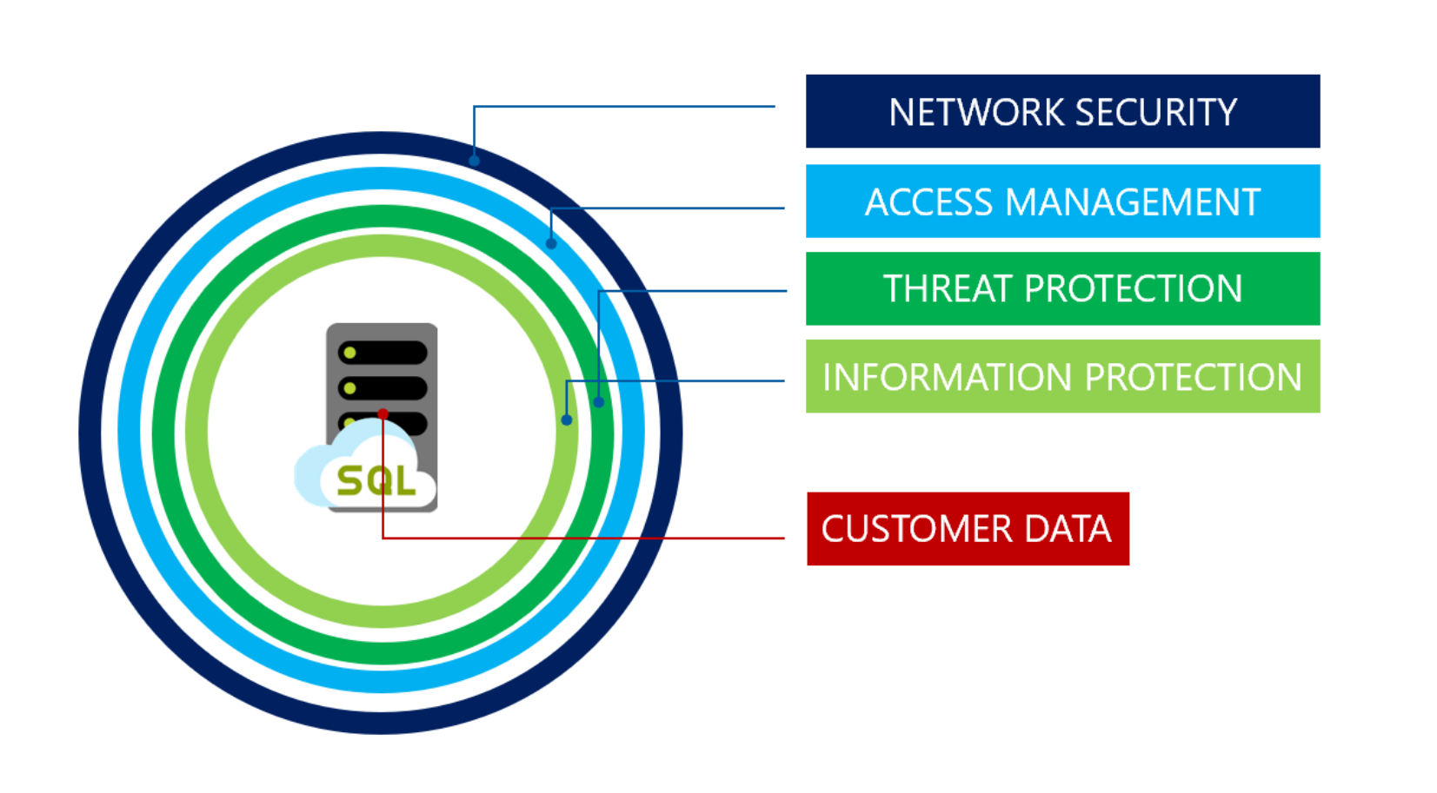
Industry-Leading Security
Network Security
IP Firewall rules
Virtual Network Firewall Rules
Access Management
Authentication
SQL Authentication
AAD Authentication
Authorization
Roles and permissions
Logins and Users
Row-Level Security
Threat Protection and Security Management
Auditing
Advanced data security
Data Discovery and Classification
Advanced Threat Protection
Vulnerability Assessment
Information Protection and Encryption
Transport Layer Security (Encryption in transit)
Transparent Data Encryption (Encryption at rest)
Always Encrypted (Encryption in use)
Dynamic data masking
SECURITY
Notes:
Objective: How Azure provides layers of protection
Talking Points:
Azure Active Directory is a comprehensive identity and access management cloud solution that provides a robust set of capabilities to manage users and groups.
Always Encrypted helps you protect sensitive data without having to relinquish the encryption keys to Azure SQL Database. Data remains encrypted at all times: in transit, in memory, on disk, and even during query processing.
Transparent Data Encryption helps you meet compliance requirements by encrypting your databases, associated backups, and transaction log files at rest without requiring changes to your applications.
Azure SQL Database supports Azure Active Directory (Azure AD) authentication provides an alternative to SQL authentication. It simplifies password management by allowing you to connect to a number of Azure services, including Azure SQL Database, using the same identity.
Row-Level security allows access to rows of data based on a user’s identity, role memberships, or query execution context.
Dynamic Data Masking lets you define masking patterns on database columns to limit the exposure of sensitive data.
Threat Detection complements Azure SQL Database Auditing and alerts on suspicious database activities at the database or logical server level.
Comprehensive, independently verified compliance. Azure is designed with a compliance strategy that helps customers address business objectives and industry standards and regulations. The security compliance framework includes test and audit phases, security analytics, risk management best practices, and security benchmark analysis to achieve certificates and attestations.
Certifications and attestations. Azure meets a broad set of international as well as regional and industry-specific compliance standards, such as ISO 27001, FedRAMP, SOC 1, and SOC 2. Azure’s adherence to the strict security controls contained in these standards is verified by rigorous third-party audits that demonstrate Azure services work with and meet world-class industry standards, certifications, attestations, and authorizations.

Slide 47
Auditing
The auditing feature tracks database events and writes events to an audit log in either Azure storage, Azure log analytics, or to an event hub.
This audit log should then be analyzed and investigated for historical activities to identify potential threats or suspected abuse and security violations.
Demo
Configure Auditing

Slide 48
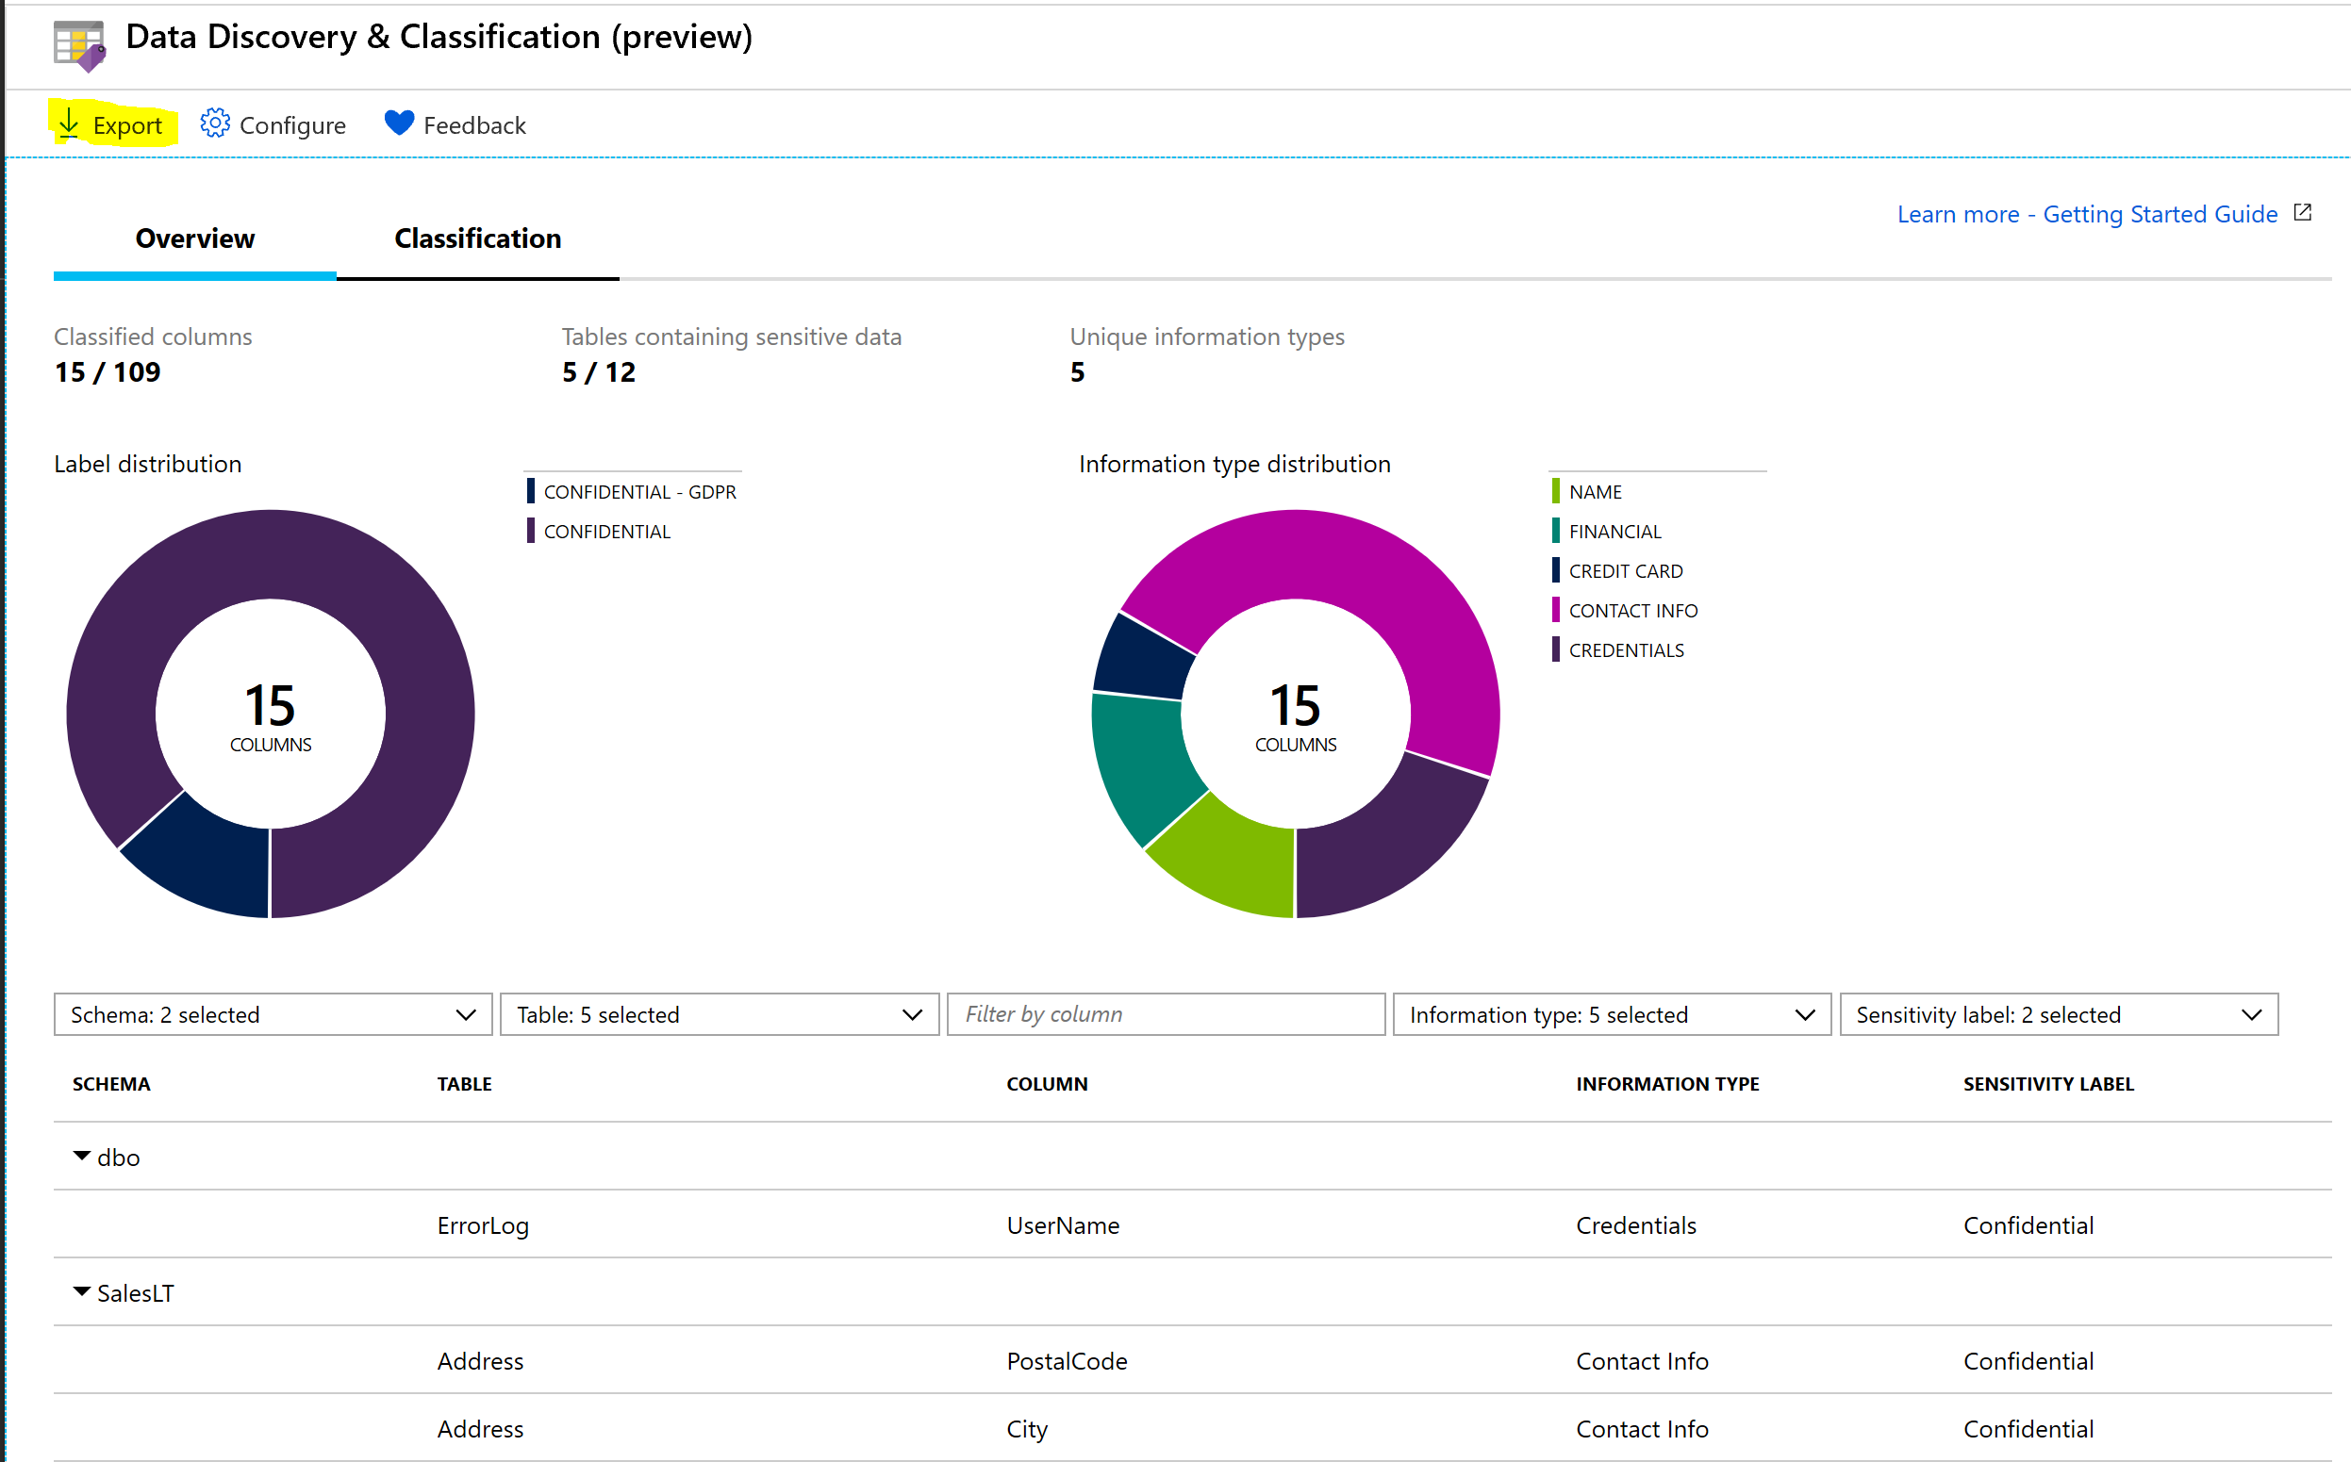
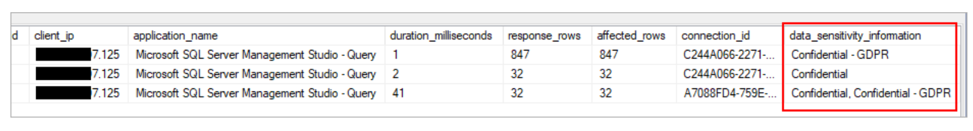
Advanced Data Security - Data discovery & classification
Built-in advanced capabilities for discovering, classifying, labeling & protecting the sensitive data in the databases for e.g. business, financial, healthcare, personally identifiable data (PII) etc.
Helps to meet data privacy standards and regulatory compliance requirements.
A new field in the audit log data_sensitivity_information logs the sensitivity classifications (labels) of the actual data that was returned by the query.

Slide 49
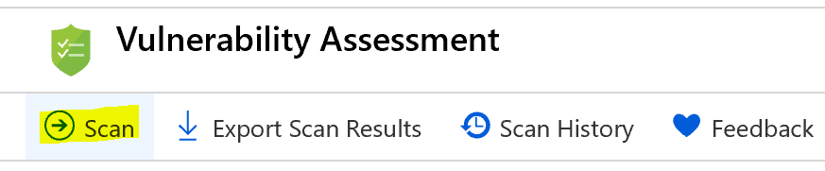
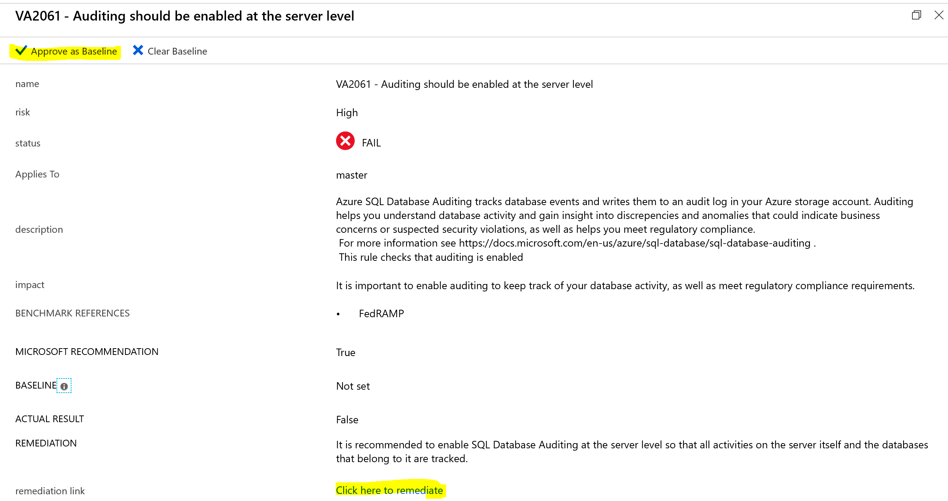
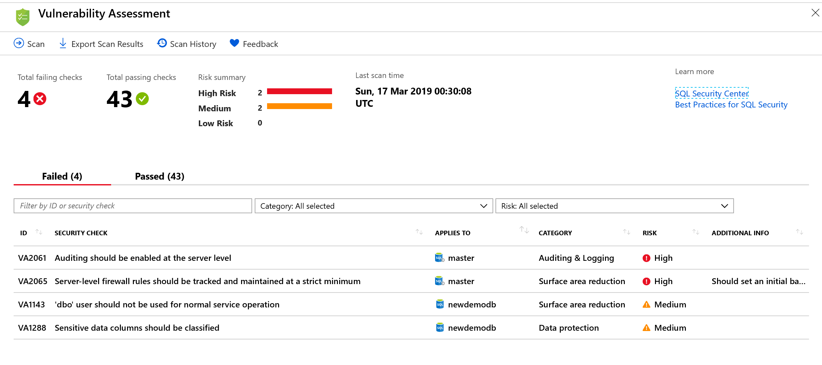
Vulnerability Assessment
1. Run a Scan
3. Drill-down to results / 4.Remediate the issue / 5.Set a baseline
2. View the report

Slide 50
Information Protection and Encryption
Dynamic Data Masking
Policy based security feature which hides the sensitive data in the result set of the query.
Dynamic data masking can be configured by the Azure SQL Database admin, server admin, SQL security manager role.
Users with administrator privileges are always excluded from masking, and see the original data without any mask.
Demo –
Done in labs
Encryption-in-transit
SQL Database secures data by encrypting data in motion with Transport Layer Security
Best practise is to specify encrypted connection (Encrypt = True) and not trust the server certificate (TrustServerCertificate = False) in applications connection string
Evaluate security risk of non-Microsoft drivers if they are not using TLS or using older version of TLS (<1.2)

Slide 51
Information Protection and Encryption
Encryption-at-rest
Uses TDE (Transparent data encryption)
Encrypts entire database using AES encryption algorithm
Encryption keys can be managed by Azure or user can bring their own key
Demo –
Transparent Data Encryption
Done in labs
Always Encrypted (Encryption in use)
Keeps data encrypted while in use
Uses two keys CEK and CMK to encrypt the data.
Only owner of the data can view the data in plain text.
The encryption key is never exposed to Azure SQL database.
Demo

